Slide 1









TEAM BITKNIGHTS
COLLEGE BAJAJ INSTITUTE OF TECHNOLOGY, WARDHA
TEAM LEADER : PARIKSHIT SATIBAWANE
Organizers
Partner

Slide 2




ORGANIZATION
PROBLEM STATEMENT
Create a System for drawing a complete polygon for any small asset (i.e. Assets developed during MGNREGA, PMAYG schemes) by knowing 3 coordinates along with the length and width.
PS Code : SH1001

Slide 3
Need of Problem Statement
Observing the overview of Developed Asset
Ensuring the accuracy of an Asset
Confirmation of Developed Asset
To check extended area during Renovation of Asset
Calculating area and perimeter of Geographic Structure

Slide 4
Advantages
More the image is clear accurate result we get.
To extract the useful structural information from different vision objects
Approximate Detection
Edge Detection can not be done from blur image.
Cost can be high depending on system used.
Human Errors can be occurred .
Disadvantages

Slide 5

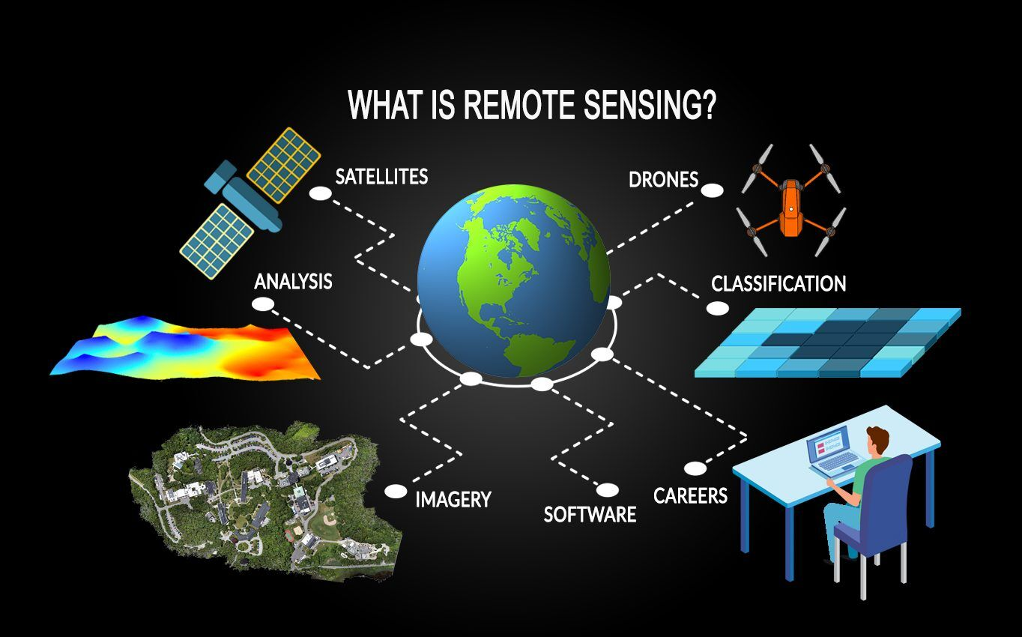
GIS AND RS ?
GEOGRAPHIC INFORMATION SYSTEMS
REMOTE SENSING

Slide 6
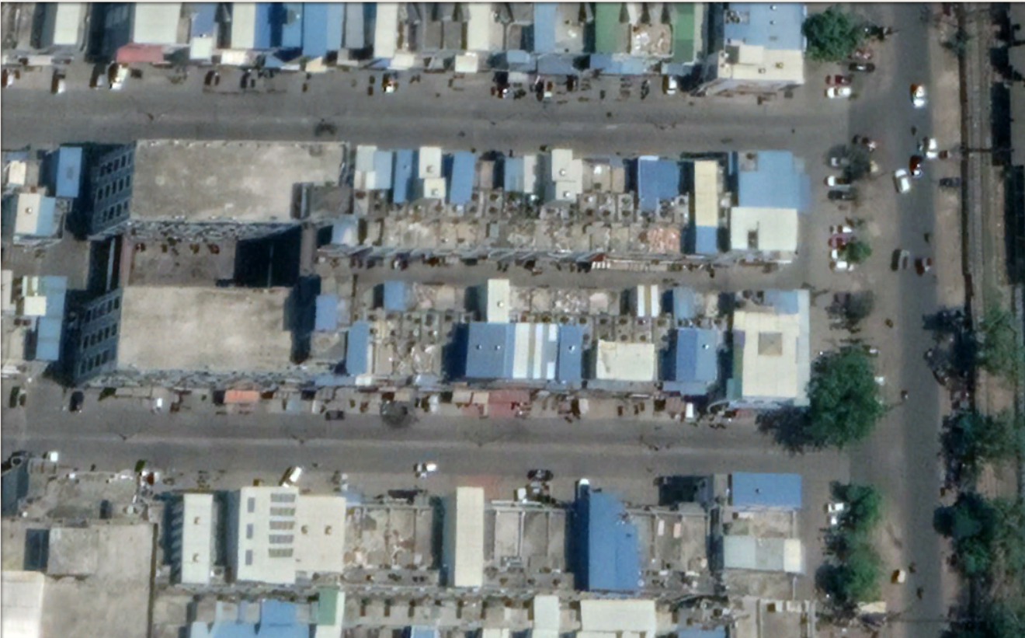
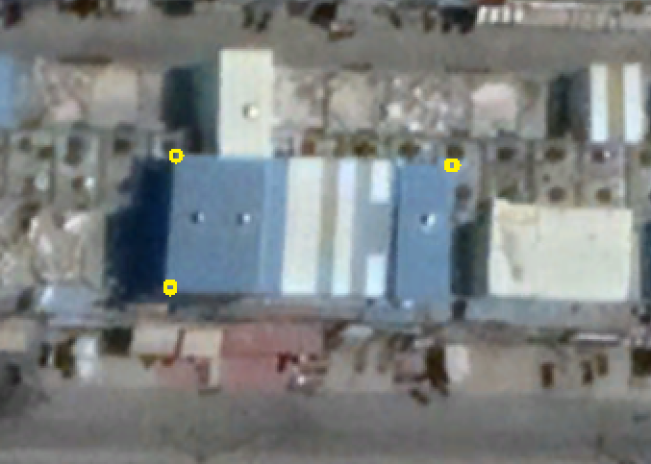
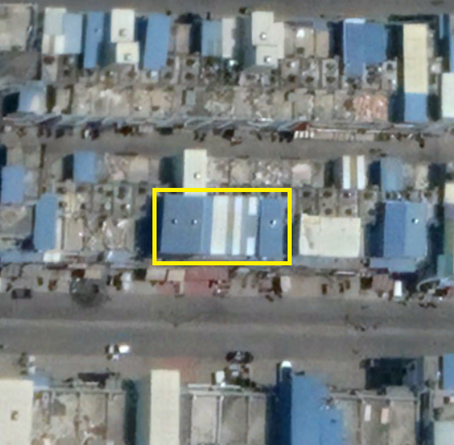
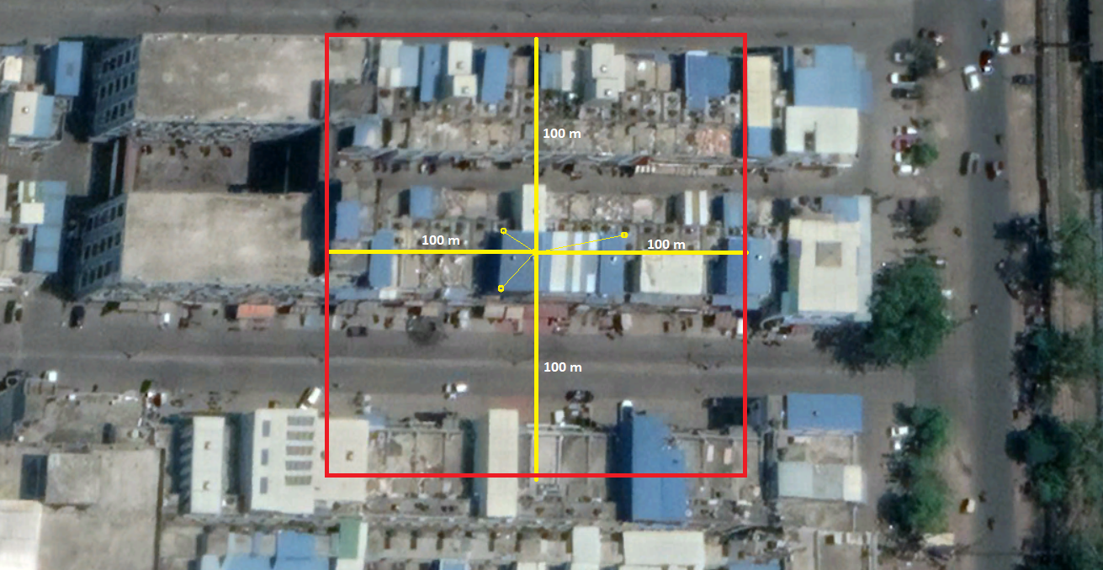
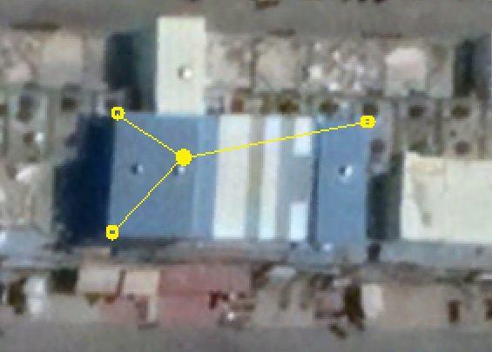
Image Processing
Result

Slide 7
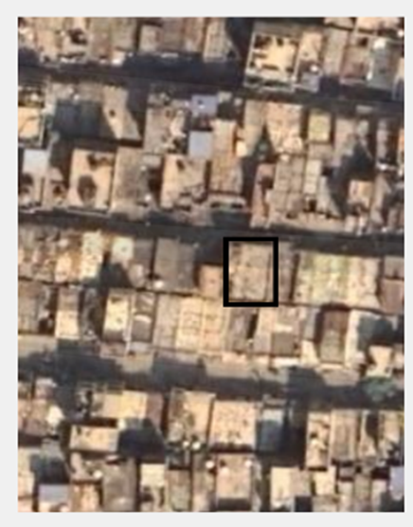
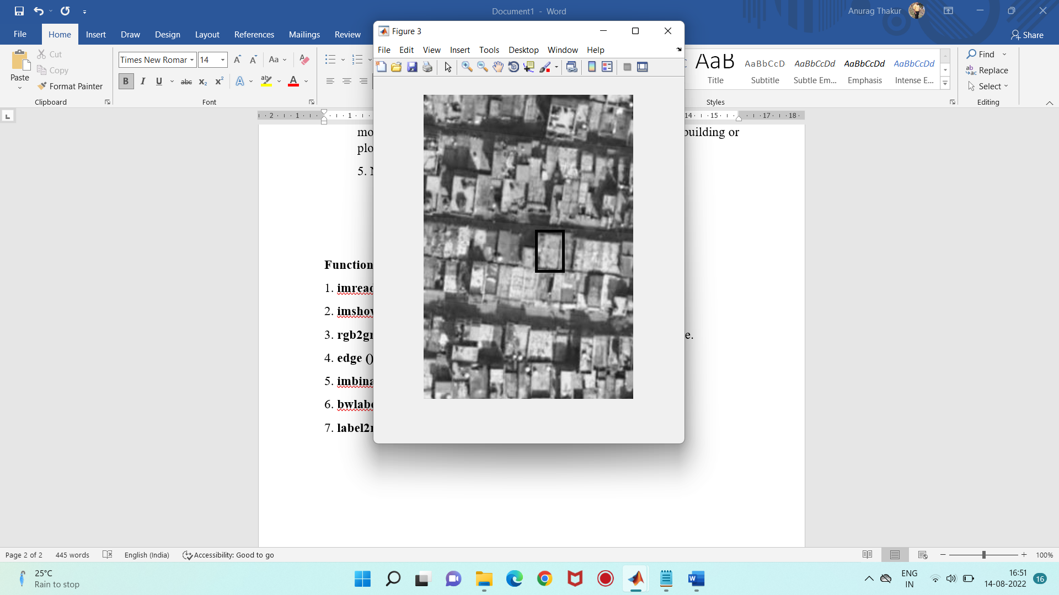
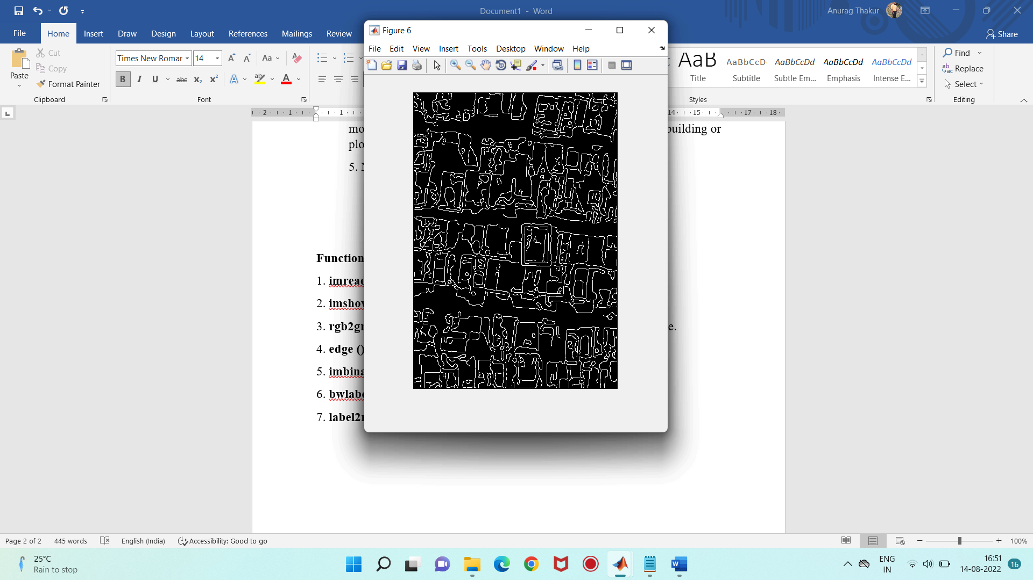
Segmentation
Result of image processing in RGB form
Converting RGB image to Greyscale image
Edge Detection using Canny’s Method

Slide 8
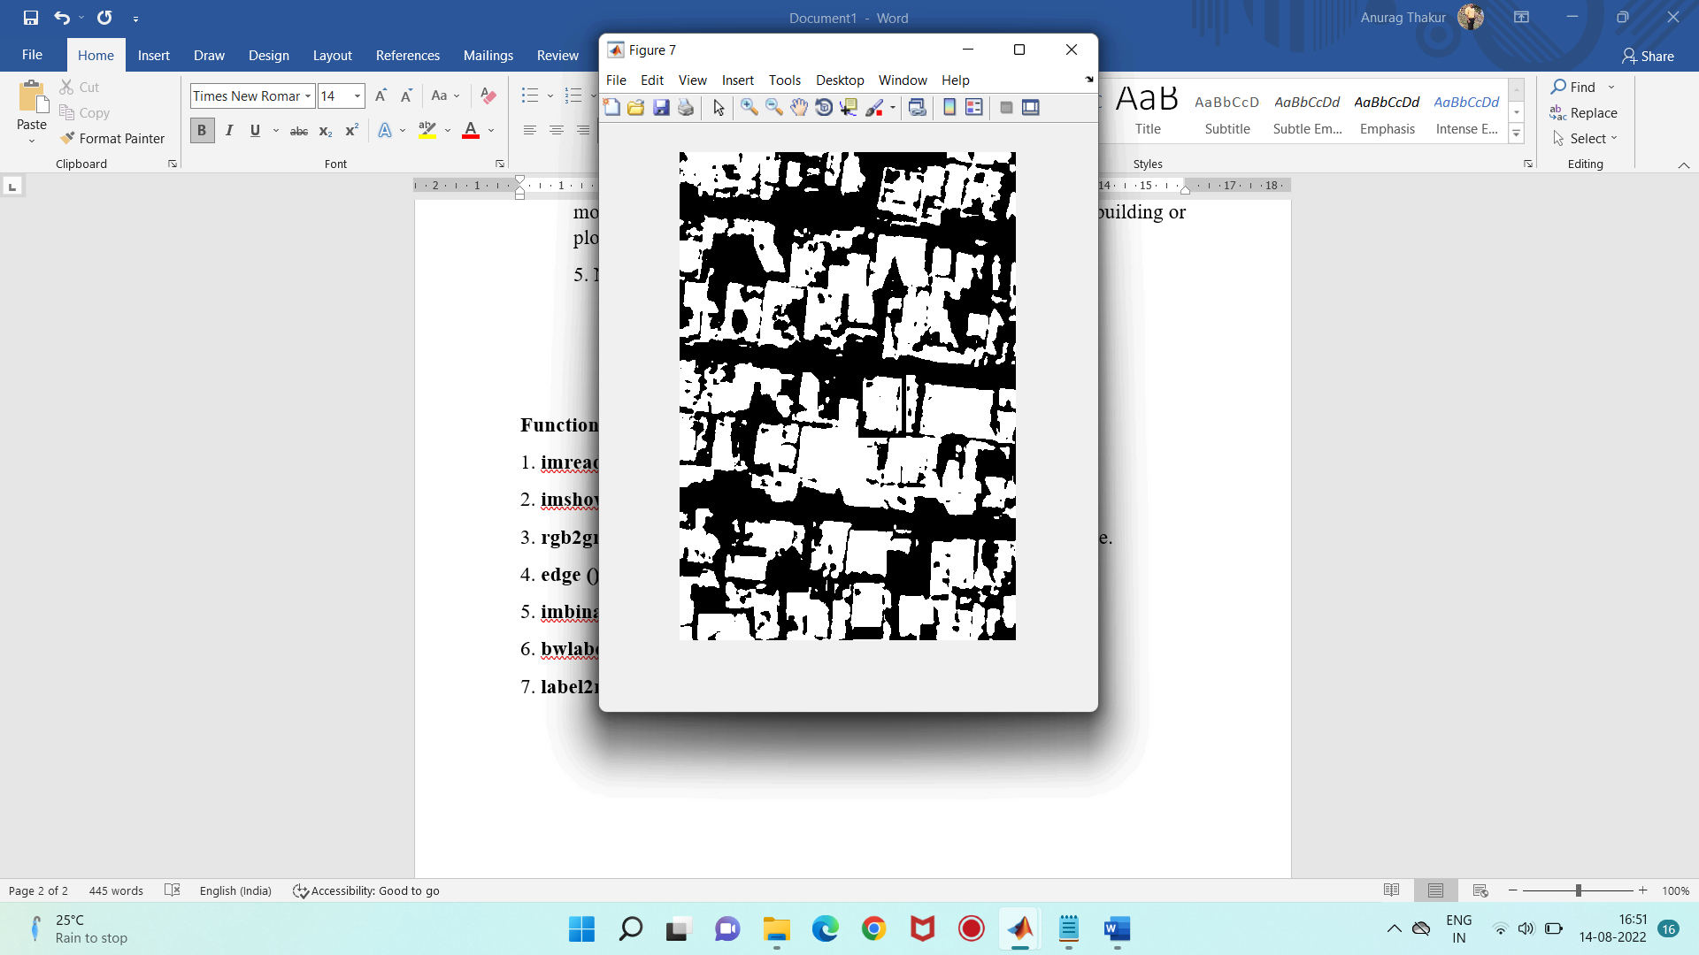
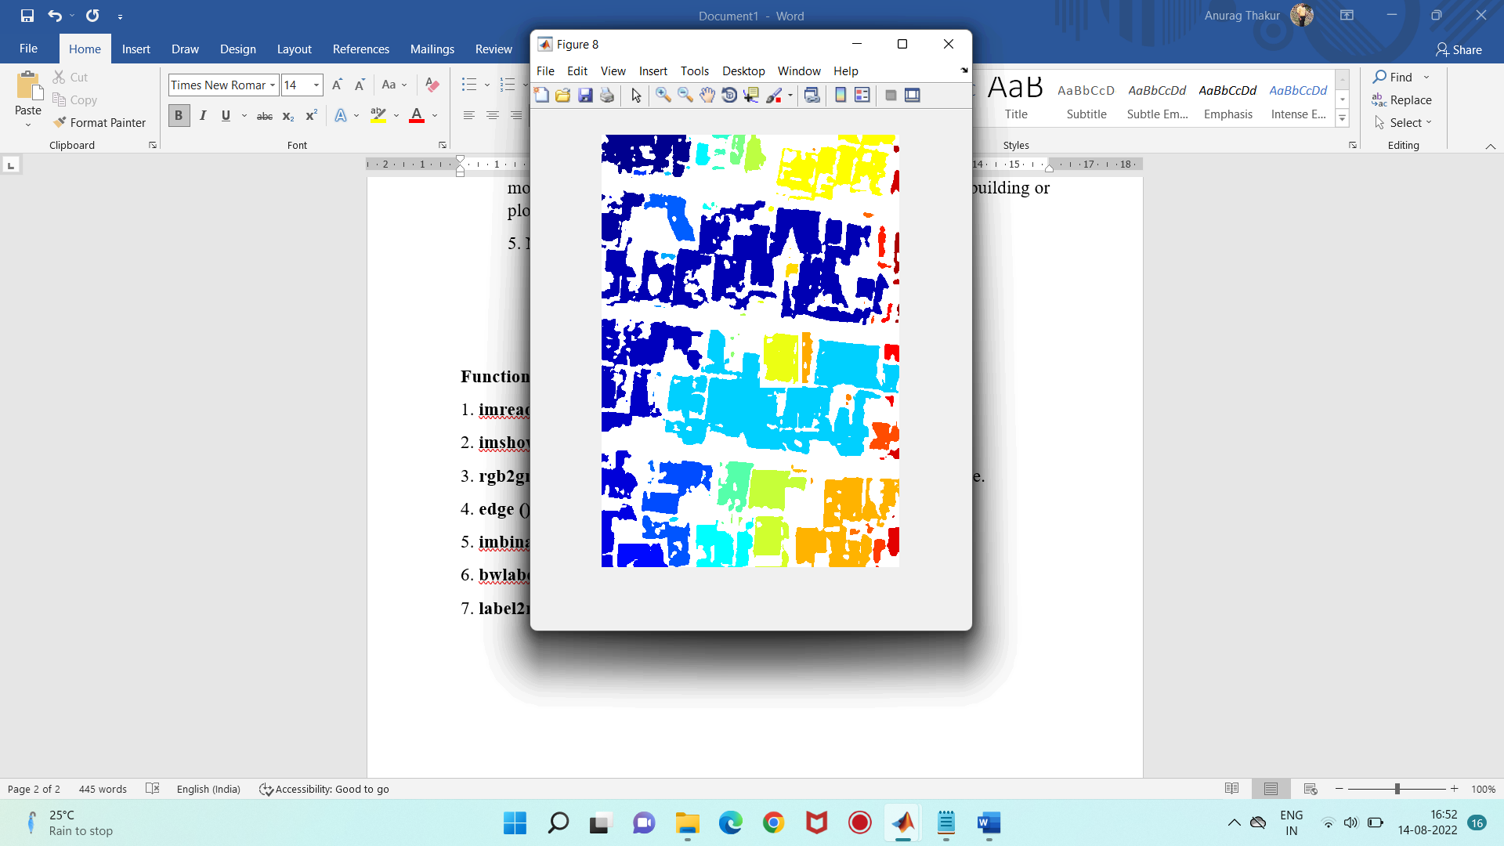
Segmentation
Edge Detection using Canny’s Method
Binarizing the Greyscale image
Converting Greyscale image back to RGB image

Slide 9
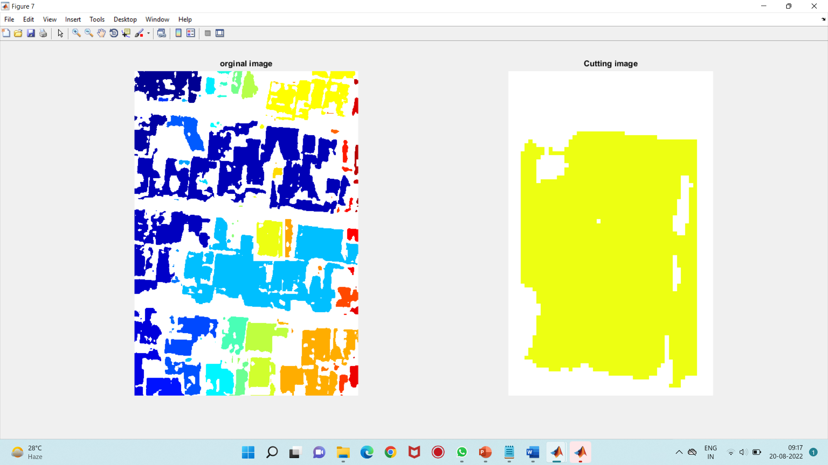
Segmentation
Converting Greyscale image back to RGB image
Final output of an Asset

Slide 10
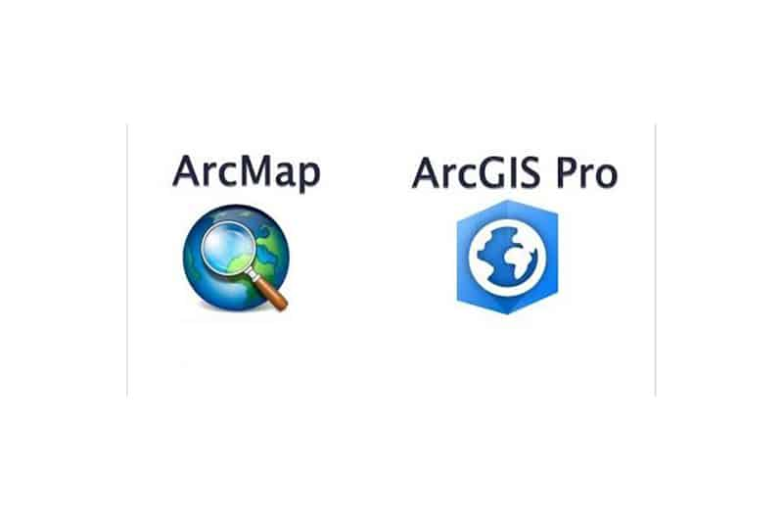


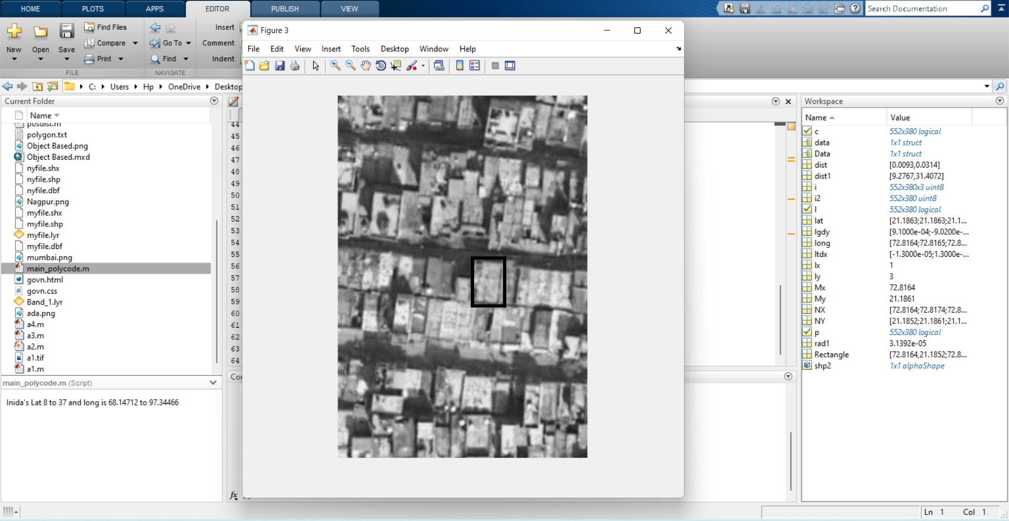
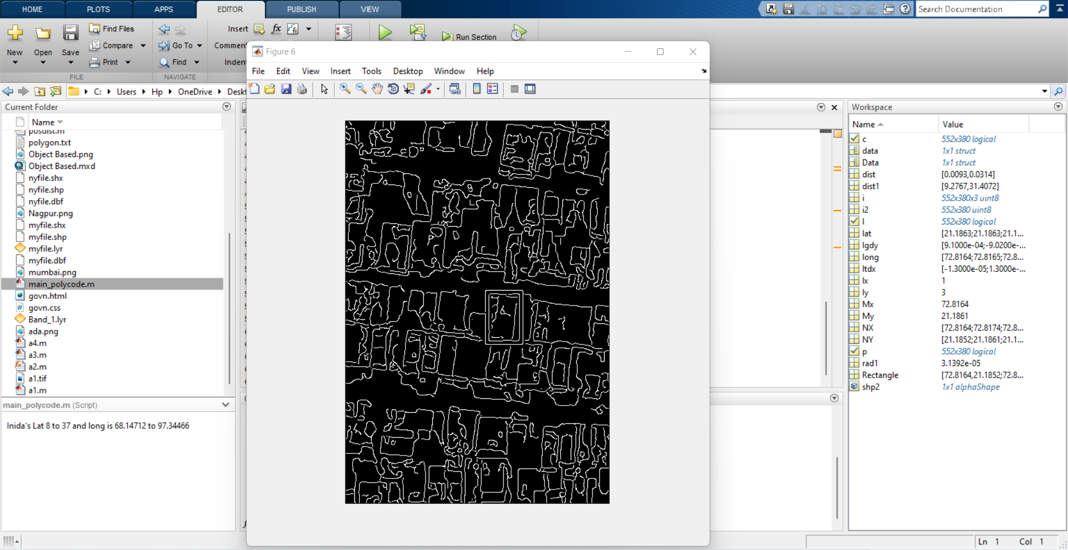
Technology Stack

Slide 11
Team
Group Member Details:
Mentor Details:
Groups Leader
Parikshit Satibawane
Members
1. Nikita Masane
2. Anurag Thakur
3. Prathamesh Pahune
4. Shantanu Potdar
5. Amit Jibhkate
Mentor 1:
Assistant Prof. Arpit Sharma
Teaching Exp : 4 Yrs
Research Exp : 4 Yrs
Mentor 2:
Mr. Pravin Rathod
Industrial Exp : 2 Yrs
Research Exp : 7 Yrs

